Slide 1
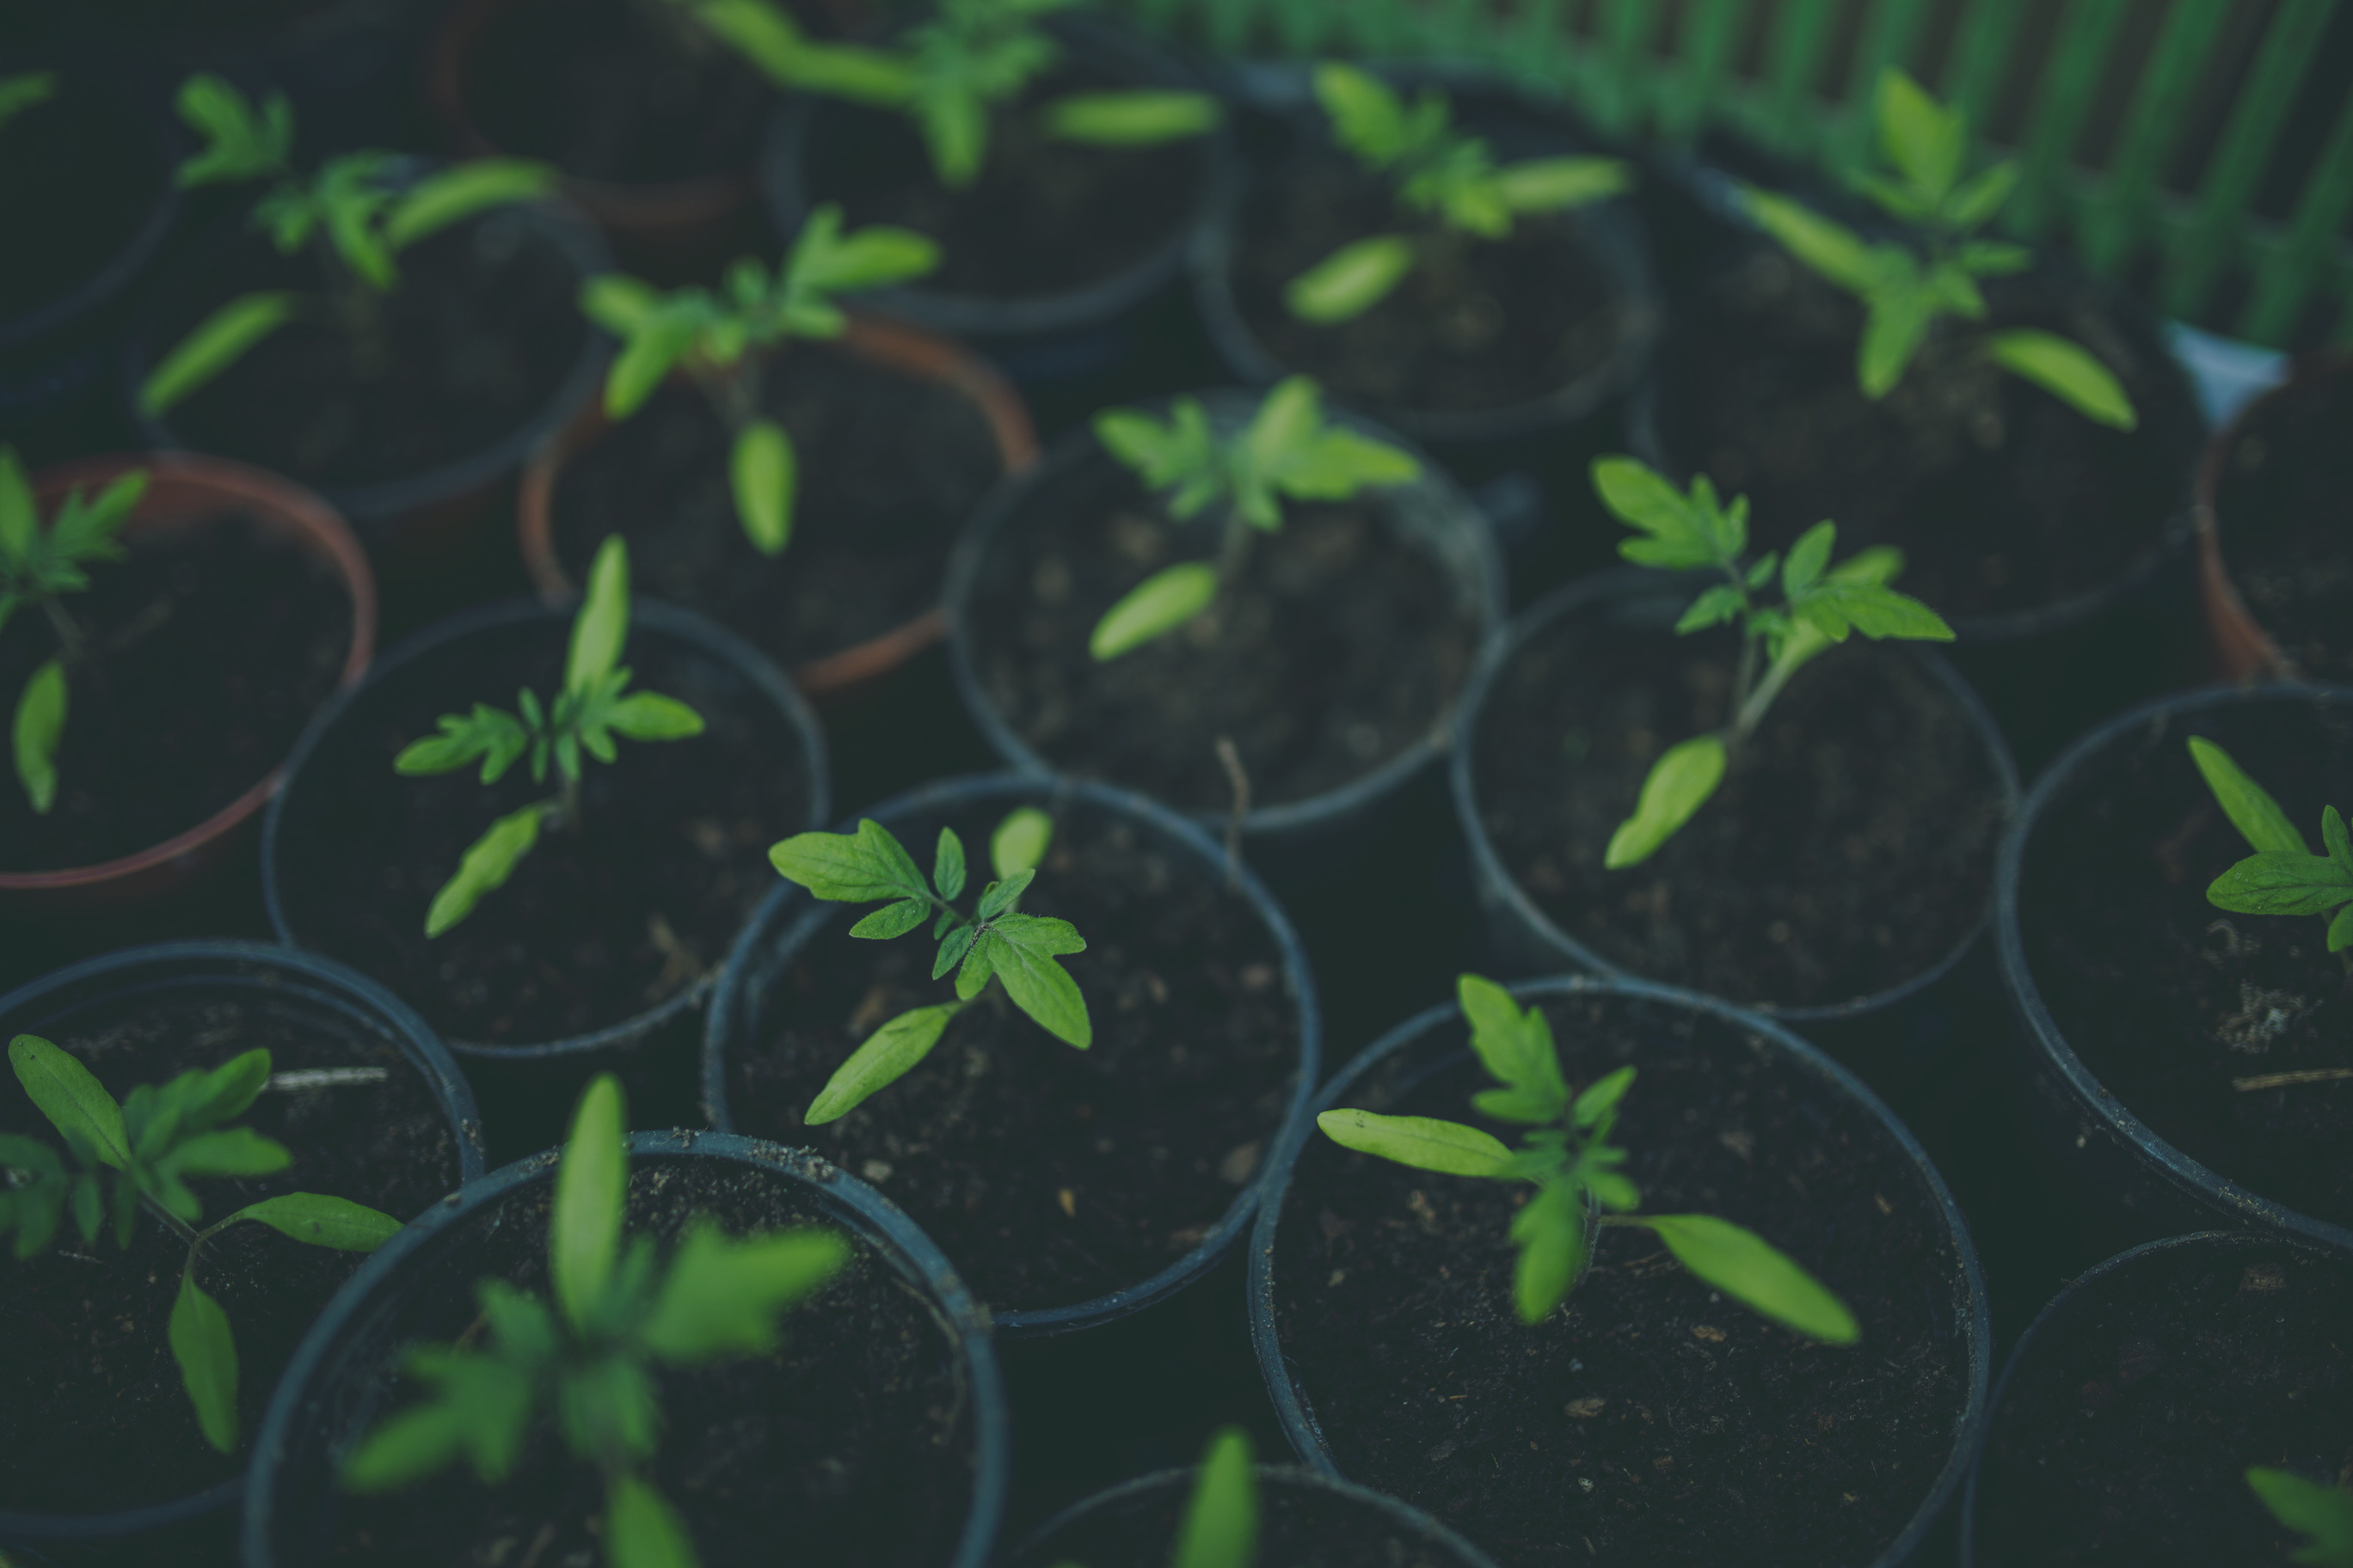
SMART GARDEN
S RESHMA
Department of Electronics and Communication Engineering
SRI VENKATESWARA COLLEGE OF ENGINEERING

Slide 2
ABSTRACT
“Water, water everywhere, not a drop of water to drink” will become true in the near future if we don’t develop sustained development goals with respect to water. The bulk of world’s water use is for AGRICULTURE. This project, works perfectly for watering home plants and gardens. This project deals with an automatic plant irrigation system which senses the moisture content of the soil and water the plants accordingly. Moisture sensor is used to sense the moisture value. AtMega328 microcontroller is programmed such that when the moisture level decreases below a minimum threshold level the relay is turned on to drive the motor to water the plants till the moisture value equals or goes up the threshold. When the moisture level is above the threshold the relay is turned off. This project is tested and found to be working fine to minimize manpower and conserve time thereby making ours, a SMART GARDEN.

Slide 3

TABLE OF CONTENTS
Introduction
Problem Statement
Components
Proposed System
System Implementation
Block Diagram and Algorithm
Conclusion and Future Scope

Slide 4

INTRODUCTION
We use water for almost everything in our day to day life. But we never really think about using it in a sustainable way. Watering plants may be a hobby for many people and they love doing it. Then there are times when we are on a vacation or busy and we totally forget to water them, leaving the plants to dry and later die. I’m sure no one wants their favourite plants to suffer. With the improvement in technology, this process can be automated and
monitored from the place we are in using IoT.

Slide 5

PROBLEM STATEMENT
In our homes water (for plants) is separately stored in a drum. We will have to refill every time the drum gets empty. If we use the existing system here, a question will arise. What if the drum gets empty and the plant’s moisture level is below the threshold?
In situations like these the relay is turned on but the
motor doesn’t drive water, since the drum is empty.
The motor keeps running and never gets turned off,
this may damage the motor. Hence we should
think of a possible solution to overcome this problem.

Slide 6
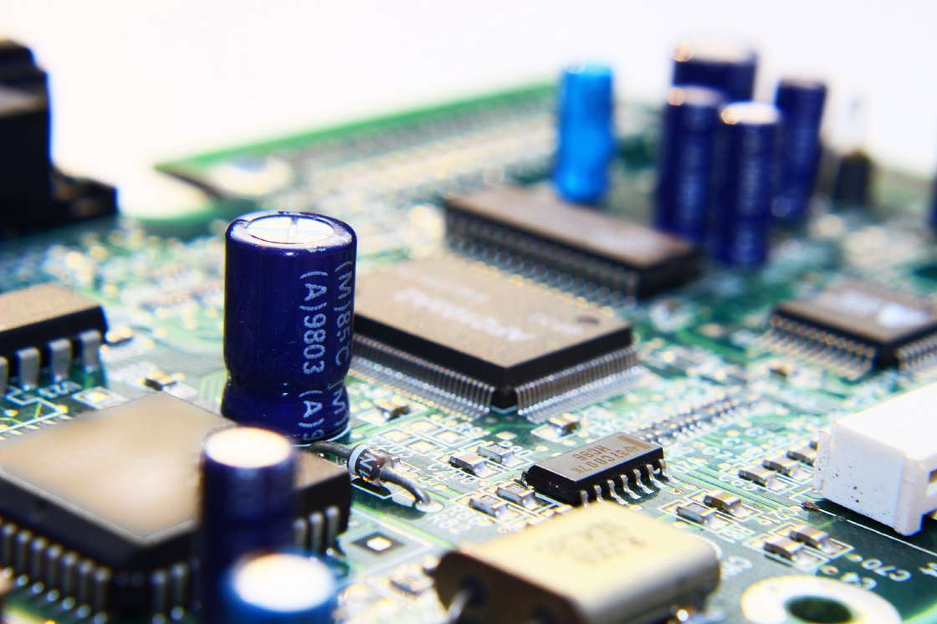
COMPONENTS LIST:
i) Hardware:
Arduino UNO
Soil Moisture Sensor
9V DC Motor
5V Relay (1 channel)
Buzzer
Resistor (0.22ohms)
9V Adapter
Soldering Iron
ii) Software:
Arduino IDLE

Slide 7
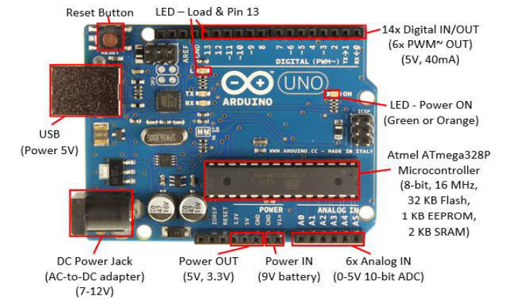
1.ARDUINO UNO :
The Arduino Uno is a type of Arduino board that is provided as an open-source board that uses an ATmega328p microcontroller in the board. The Arduino Uno contains a set of analog and digital pins that are input and output pins which are used to connect the board to other components. There are a total of fourteen I/O pins placed inboard in which six are analog input pins. The board has a USB connection that can be used to a power supply to the board.
Here Arduino UNO is used to:
Read the input from the sensor
Print the output on the serial monitor
Turn on the relay to activate the motor
Turns on the buzzer at crucial times

Slide 8
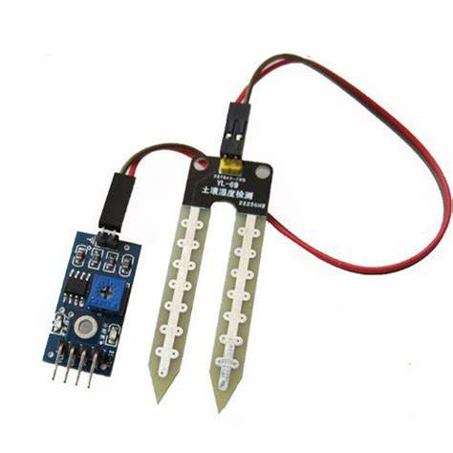
2. SOIL MOISTURE SENSOR
The sensor consists of two probes which are used to measure the volumetric content of water. The two probes allow the current to pass through the soil and then it gets the resistance value to measure the moisture value.
When there is more water, the soil will conduct more electricity which means that there will be less resistance. Therefore, the moisture level will be higher.
Dry soil conducts electricity poorly, so when there will be less water, then the soil will conduct less electricity which means that there will be more resistance.Therefore, the moisture level will be lower.

Slide 9
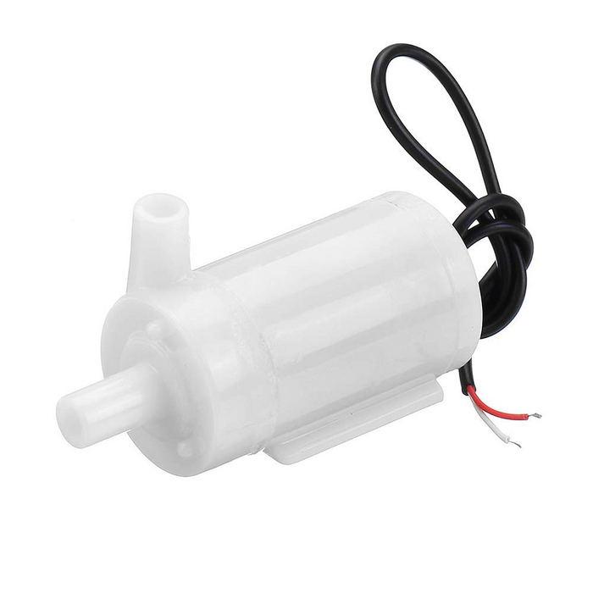
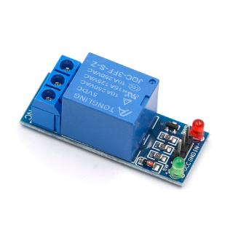
3. DC SUBMERSIBLE MOTOR- 9V
A DC motor is an electrical machine that converts electrical energy into mechanical energy. In a DC motor, the input electrical energy is the direct current which is transformed into the mechanical rotation. Relay acts as a switch for this motor. When the relay is conditioned to be ON the motor starts to drive water from the drum. A vinyl tube is used for this purpose
4. RELAY- 5V
A relay is an electromagnetic switch that is used to turn on and turn off a circuit by a low power signal, or where several circuits must be controlled by one signal.

Slide 10
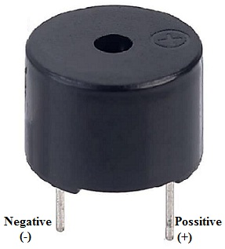
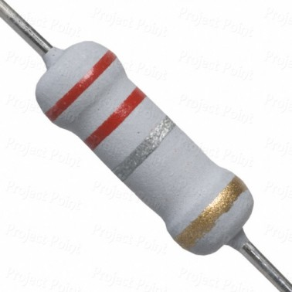
5. BUZZER
An audio signaling device like a beeper or buzzer may be electromechanical or piezoelectric or mechanical type. The main function of this is to convert the signal from audio to sound. Generally, it is powered through DC voltage and used in timers, alarm devices, printers, alarms,
6. RESISTOR- 0.22 OHMS
The main purpose of resistor is to reduce the current flow and to lower the voltage in any particular portion of the circuit.

Slide 11
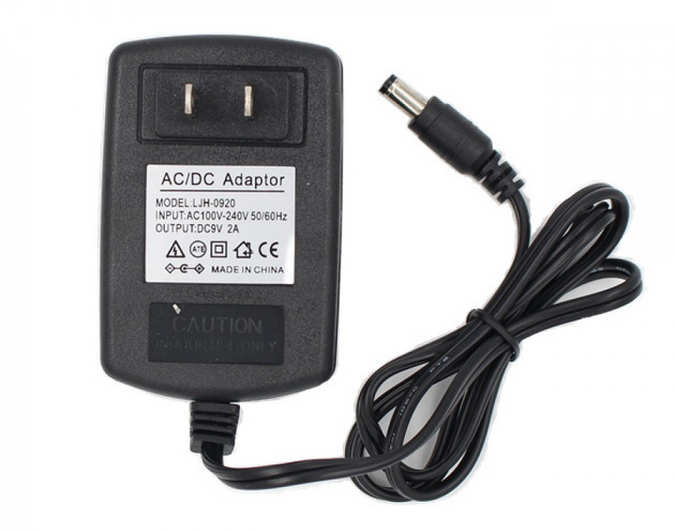
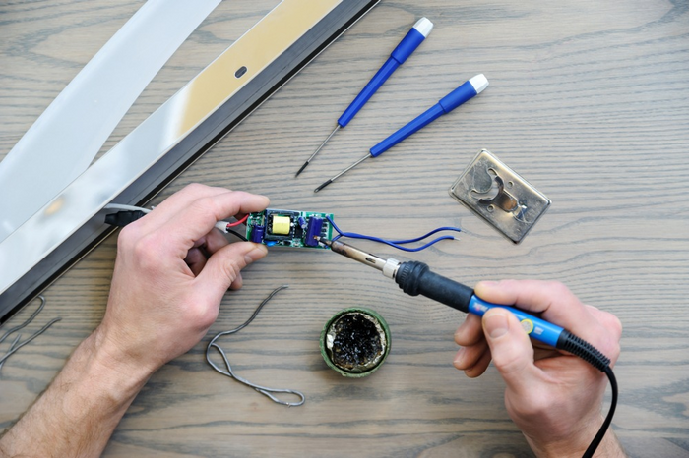
7. 9V AC ADAPTOR
AC adaptor plugs into a standard electrical outlet and converts the AC electrical current from the wall outlet to the specifications needed by the electrical device that's plugged in. Here the 230 V direct supply is converted to 9V that is required by the motor. This gives a constant voltage.
8. SOLDERING IRON KIT
Soldering is a technique for joining metal parts together. It involves melting a metal known as solder into the space between two metal components. When this solder cools and hardens, it forms a permanent connection between the parts.

Slide 12

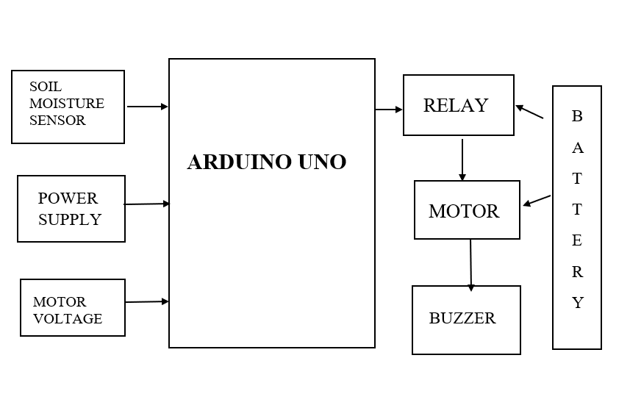
PROPOSED SYSTEM- BLOCK DIAGRAM

Slide 13
SYSTEM IMPLEMENTATION
WHAT WE KNOW?
>
when motor drives water
Work done
Power
Voltage
work motor doesn't drive water
Work done
Power
Voltage
WHAT WE CAN DO?
We can use a resistor across the motor and find the voltage drop at both the situations, setting a threshold for the motor voltage. The resister value is calculated using multimeter and implemented on the code. The moisture threshold and the motor threshold are decided after visually seeing.

Slide 14

PROPOSED SYSTEM- ALGORITHM:
1. START
2. SENSOR MEASURES THE MOISTURE LEVEL
3. IF VALUE > MOISTURE THRESHOLD
3.1. RELAY- ON
3.2. CHECK VOLTAGE ACROSS RESISTOR
3. 3. IF VOLTAGE> VOLTAGE THRESHOLD
3.3.1 RELAY- ON
3.3.2 WATER TILL VALUE REACHES THRESHOLD
3. 4. IF VOLTAGE < VOLTAGE THRESHOLD
3.4.1. RELAY- OFF
3.4.2. BUZZER ON FOR 10 SECONDS
3.4.3. BUZZER OFF
4. IF VALUE < MOISTURE THRESHOLD
4.1 RELAY- OFF
5. STOP

Slide 15

WHAT OUR SYSTEM DOES ?
Checks the moisture level of the soil and water the plant accordingly .
Alerts us using buzzer if the drum is empty and the plant needs water.

Slide 16
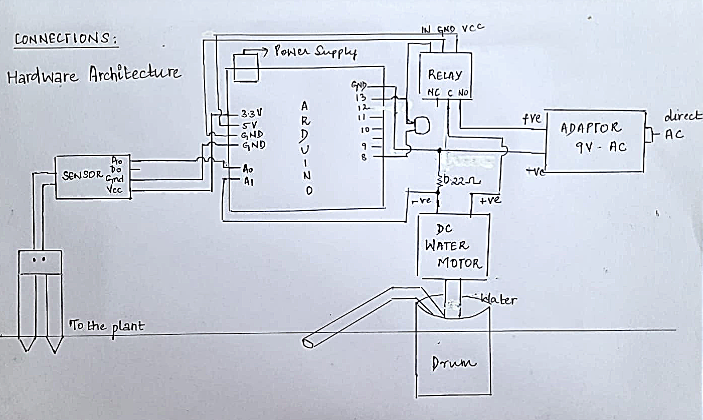
PROPOSED SYSTEM- HARDWARE SKETCH

Slide 17
CHALLENGES
SOLUTIONS
The controllers to the Arduino were quite challenging, because of a single mistake can damage any electrical part.
The 9V DC batteries used in this project drained quickly.
Problems in arduino idle
The controllers were taken good care . They were kept away from water while experiment. After the experiment they were packed and kept aside.
They were replaced with 9V AC adaptor, for equal and continuous flow.
Ardino idle was updated and downloaded from first.

Slide 18

CONCLUSION
The automatic irrigation system using Arduino UNO has been experimented and the results are promising for home plants. Hence this system can be used when we are on a vacation. This system is cost- efficient and easily portable.
Finally, this project is tested and found to be working
fine to minimize manpower and conserve time thereby
making ours, a SMART GARDEN.

Slide 19

FUTURE SCOPE
This system can be expanded to include various other options in small scale as well as large scale. According to the researchers,
“Early morning is the optimal time to water plants, avoiding the hottest part of the day when this will quickly evaporate and allowing a chance for plant roots to take in what they need. Late afternoon or early evening is ok for watering, so that the plants have time to drink up the water before the heat of the following day.”
Hence, we can make our system work only during those
times using RTC module. This can also be varied seasonally
by using temperature and humidity sensor. Finally, we can
our replace our resistive sensor with capacitive sensor to get
more accurate results and work well for longer period of time.
This project has even wider scopes to be dealt with.

Slide 20

THANK YOU

